Slide 1
3D Visualisation of Sensor Information on Google Android platform
Interface prototype

Slide 2
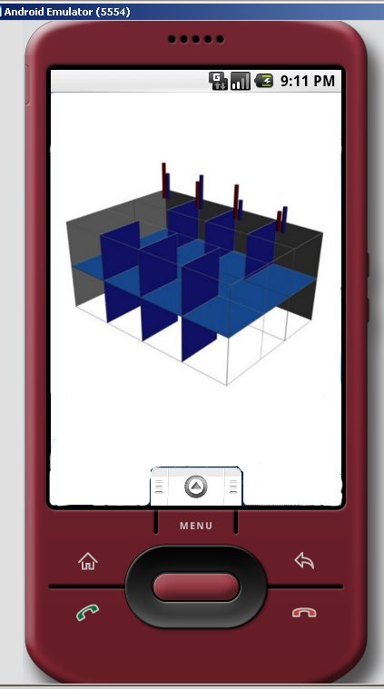
An idea of how the interface could represent data in 3D.
Bars on the „roof” correspond to different readings, e.g. temperature and humidity

Slide 3
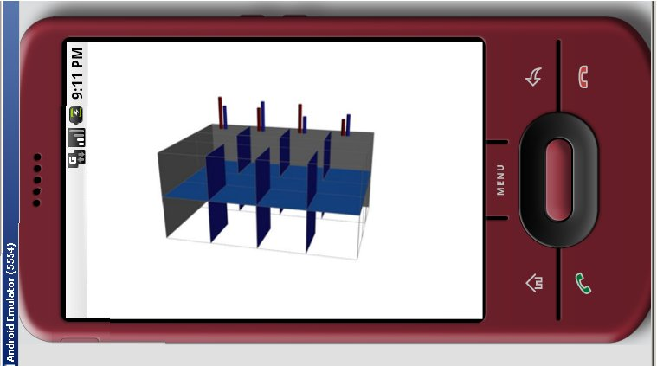
User would be able to navigate in the 3D space to get a better view of the model.

Slide 4
After clicking on one of the indicators/bars, some options would be presented:
Refresh data
Info
Settings

